Slide 1
PRODUCT DASHBOARD USING POWER BI
AKASH V

Slide 2
Tool used: Jupyter Note Book
Libraries: Pandas, Matplotlib

Slide 3
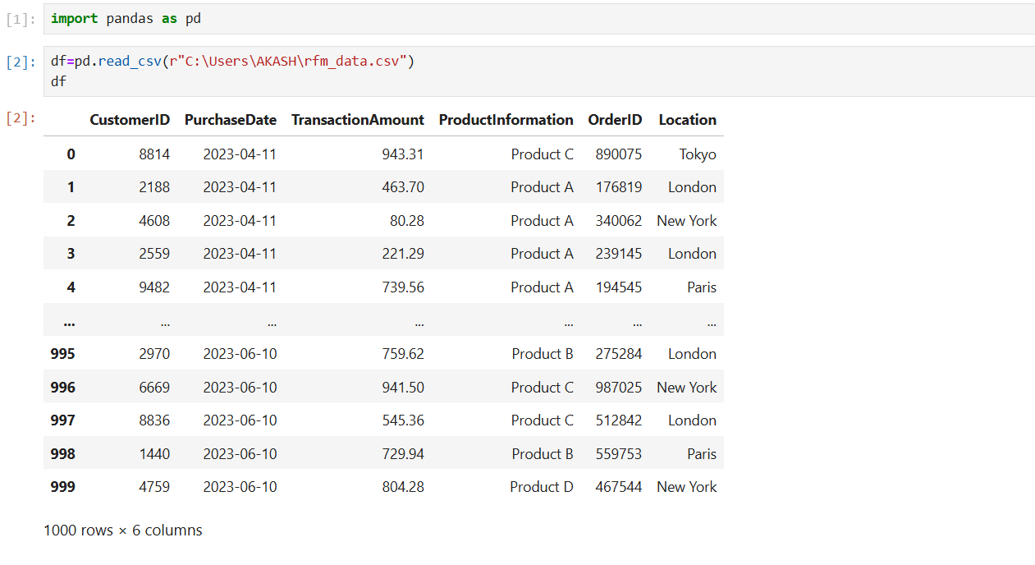
PYTHON CODING

Slide 4
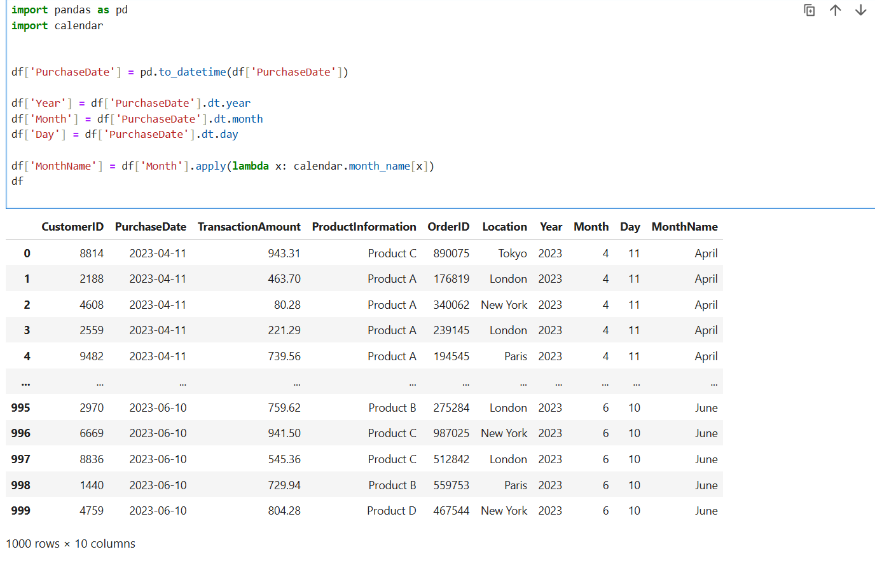

Slide 5
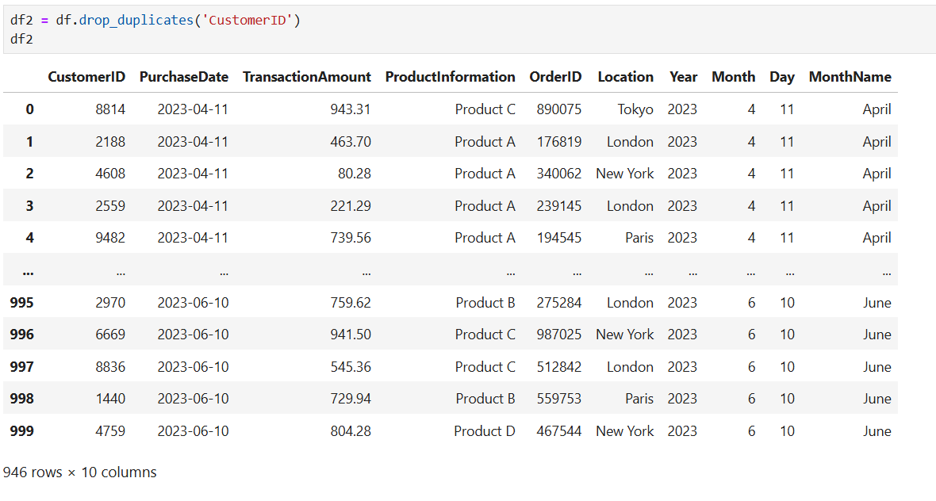

Slide 6
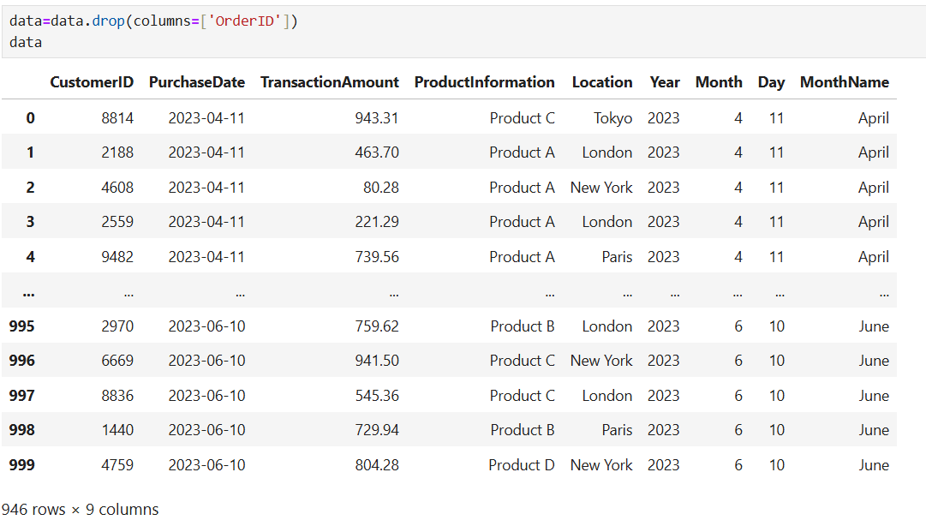

Slide 7
PYTHON TO POWER BI
Using the python Script the data was exported to power BI from python

Slide 8
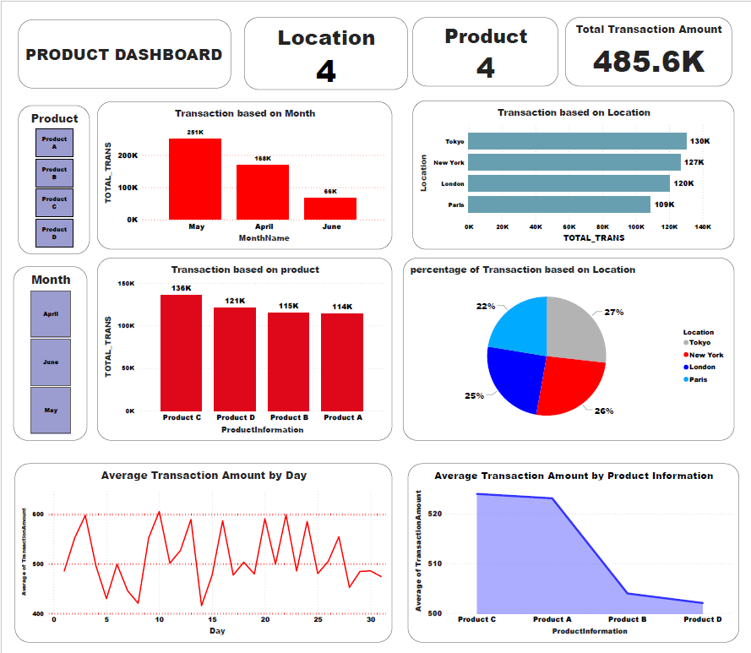

Slide 9
INSIGHTS
The total transaction amount across all locations and products is 485.6K.
May has the highest transaction amount at 251K.April follows with 168K.June has the lowest transactions at 66K.
Product C generates the highest transactions at 136K.
Tokyo leads with the highest transaction amount at 130K.
Tokyo accounts for the largest share (27%)
There are fluctuations throughout the month, with daily averages ranges between 400 and 600 units

Slide 10


